Slide 1


SNAP BOT
BY: 1602-20-737-019-D.Lalitha Sowjanya
1602-20-737-011-T.Devi SRujana
1602-20-737-051-B.Suresh Kumar

Slide 2
Actors with Use Cases:
User System
Upload Picture Displays menu
Cartoonizer Cartoonizes picture
Size Reducer Reduces the size of the picture
Add Frame Adds frame to the picture
Image Blur Blurs the image
Background Blur Blurs the Background
Add Text Adds Text to the picture
Black and White Black and White effect

Slide 3
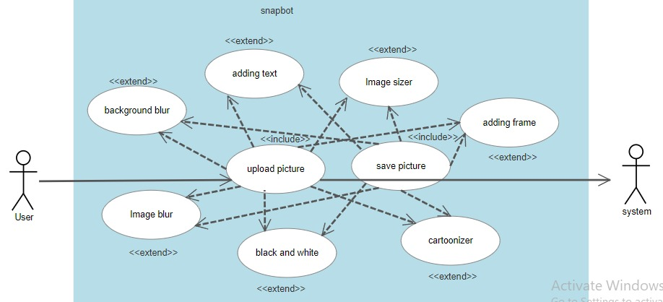
Use Case Diagram:

Slide 4
Use Case Descriptions:
Use Case-1:
Name : Cartoonizer
Actors : User, System
Description : Allows user to cartoonize the picture
Pre-Conditions : Picture upload
Post-Conditions : Save or Discard
Main Flow:
User | System
1. Chooses Cartoonize option.
 | 2. Cartoonizes picture, display and asks for save or discard.
3. Enters save or discard.
 | 4. Works according to the user’s choice.

Slide 5
Use Case-2:
Name : Add Frame
Actors : User, System
Description : Allows user to add frame to the picture
Pre-Conditions : Picture upload
Post-Conditions : Save or Discard
Main Flow:
User | System
1. Chooses Add Frame option.
 | 2. Adds frame to the picture, display and asks for save or discard.
3. Enters save or discard.
 | 4. Works according to the user’s choice.

Slide 6
Use Case-3:
Name : Black and White
Actors : User, System
Description : Allows user to Add black and white effect to the picture
Pre-Conditions : Picture upload
Post-Conditions : Save or Discard
Main Flow:
User | System
1. Chooses Black and White option.
 | 2. Adds Black and White effect to the picture, display and asks for save or discard.
3. Enters save or discard.
 | 4. Works according to the user’s choice.

Slide 7
Use Case-4:
Name : Background Blur
Actors : User, System
Description : Allows user to Blur Background of the picture
Pre-Conditions : Picture upload
Post-Conditions : Save or Discard
Main Flow:
User | System
1. Chooses Background Blur option.
 | 2. Removes background of the picture, display and asks for save or discard.
3. Enters save or discard.
 | 4. Works according to the user’s choice.

Slide 8
Use Case-5:
Name : Blur Image
Actors : User, System
Description : Allows user to Blur the picture
Pre-Conditions : Picture upload
Post-Conditions : Save or Discard
Main Flow:
User | System
1. Chooses Image Blur option.
 | 2. Blurs the picture, display and asks for save or discard.
3. Enters save or discard.
 | 4. Works according to the user’s choice.

Slide 9
Use Case-6:
Name : Add Text
Actors : User, System
Description : Allows user to add text to the picture
Pre-Conditions : Picture upload
Post-Conditions : Save or Discard
Main Flow:
User | System
1. Chooses Add Text option.
 | 2. Adds text to the picture, display and asks for save or discard.
3. Enters save or discard.
 | 4. Works according to the user’s choice.

Slide 10
Use Case-7:
Name : Image Resizer
Actors : User, System
Description : Allows user to resize the picture
Pre-Conditions : Picture upload
Post-Conditions : Save or Discard
Main Flow:
User | System
1. Chooses Resize Image option.
 | 2. Resizes the picture, display and asks for save or discard.
3. Enters save or discard.
 | 4. Works according to the user’s choice.

Slide 11
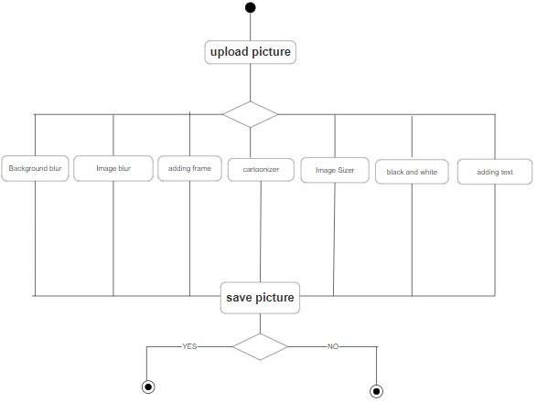
Activity Diagram:

Slide 12
Thank you!!

